Slide 1
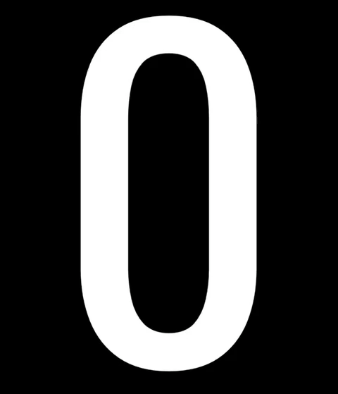
Open Usage
ZPE
ZER
PA
Below US$100M p.a.
Zer0pa SAL v6.0

